Slide 1
Computerized Dance Classroom
Using kinect to evaluate dance performances
Stylianos venieris
Marcin baginski
Theo pavlakou
Hesam ipakchi
Zeping xue
Yijie ge

Slide 2
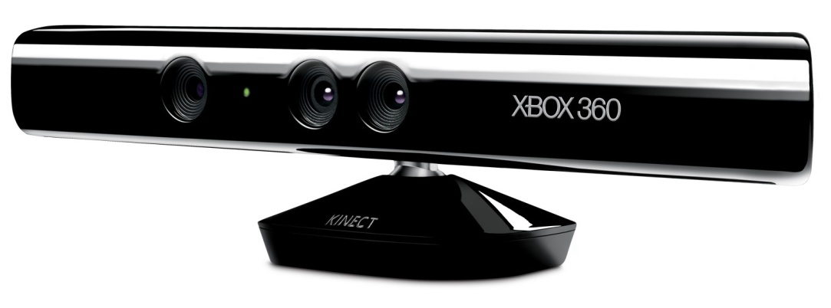


Project Background
RGB-D cameras:
Microsoft Kinect
Asus Xtion
other
OpenNI
NiTE
Notes:
An emergence of RGB-D cameras, such as Microsoft Kinect or Asus Xtion, has lead a development of applications with a completely new type of user interaction
With an RGB-D camera, users are not required to hold any controllers in their hands, but perform gestures in front of the camera, which are automatically interpreted by the device

Slide 3
Outline
Project Aims
Evaluation of Kinect, OpenNI and NiTE
Automatic Scoring System
Motionless Activity Detector
Translation Module
Data Alignment Module
Data Analysis Module
Application and its features
Extensions
Commercial Aspect

Slide 4
Project Aims
Bring Kinect technology to a dance classroom
Evaluate tracking capabilities of Kinect, OpenNI and NiTE
Develop software for recording dance performances
Create algorithms for automatic recognition of errors and comparison of two dance movements
Make the application user friendly

Slide 5
Evaluation of Kinect, OpenNI and NiTE
Camera range:
60 cm – recognises subjects
120 cm – starts tracking
410 cm – stops tracking
Lighting conditions:
No effect on the tracking capabilities
Velocity of movement
Faster movement can decrease the precision of data returned from NiTE
Camera angle relative to the performers
If a person stands at a 90° to the camera, it can lose tracking of the limbs which are covered by the body

Slide 6
Evaluation of Kinect, OpenNI and NiTE
Interference between multiple cameras
Careful placement of cameras can minimise the interference
Occlusion in front of the camera
Creates a problem, camera loses tracking if a part of the body is covered by an object
Number of tracked people
In theory constrained only by how many can actually fit in the camera range
In practise, inevitable occlusion between multiple people limits the number to about 2

Slide 7
Automatic Dance Scoring - System
Motionless Activity Detector
Translation Module
Score
Data Alignment Module
Data Analysis Module
Dance
Main purpose of the system – compare and score the student’s performance with respect to the teacher’s
Divided into four manageable modules, where the output of the former is the input of the latter

Slide 8
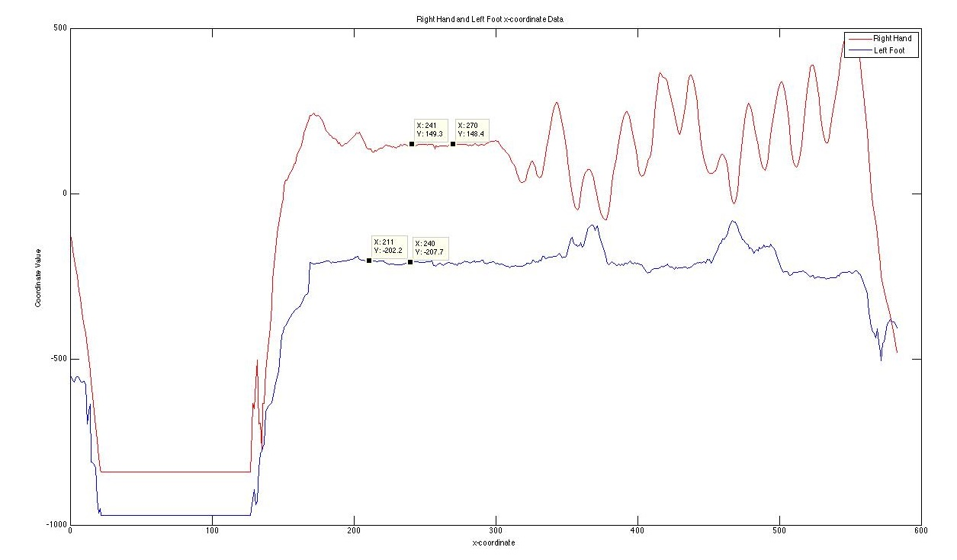
Automatic Dance Scoring – Motionless Activity Detector
Motionless Activity Detector
Before performing any movement, the person needs to stand still for approx. 2 s for the software to calibrate
Motionless Activity Detector returns a frame number in the recording where the person was not moving

Slide 9
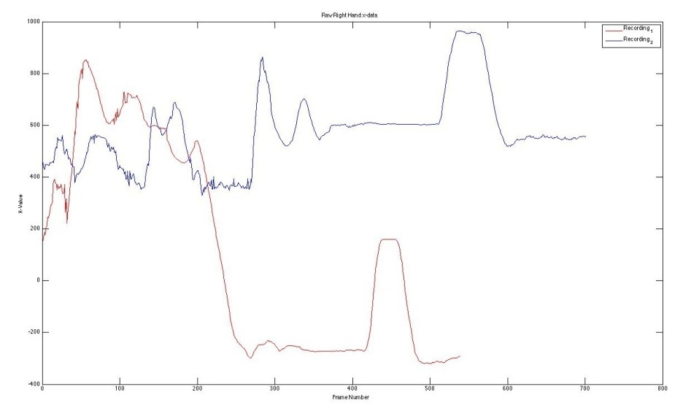
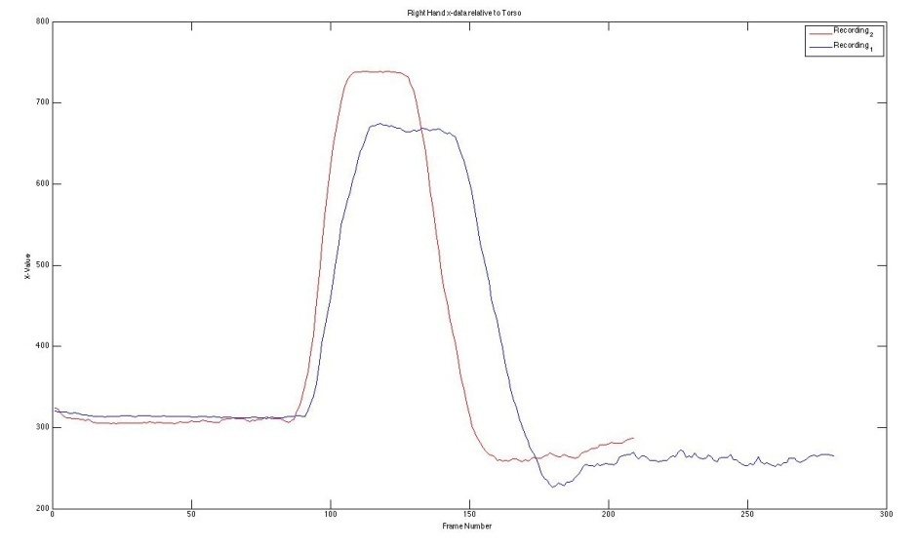
Automatic Dance Scoring – Translation Module
Translation Module
Takes the frame number from the Motionless Activity Detector and discards all the data which happened before this frame
Additionally, ‘normalises’ the data, such that the exact position of the subject in the camera range not included any more
Before
After

Slide 10
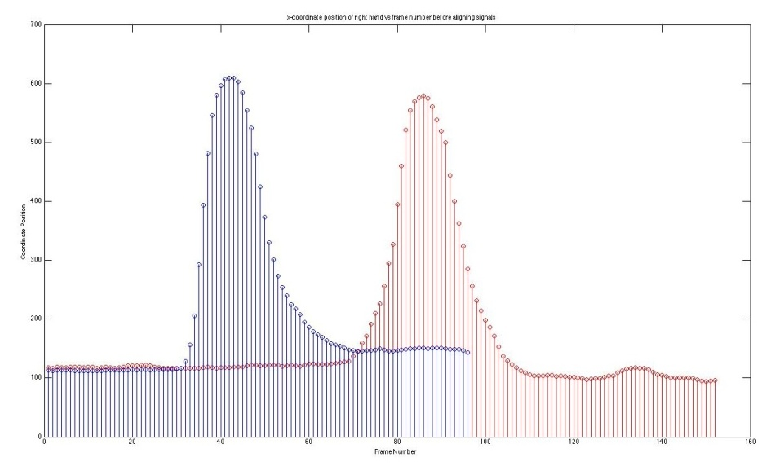
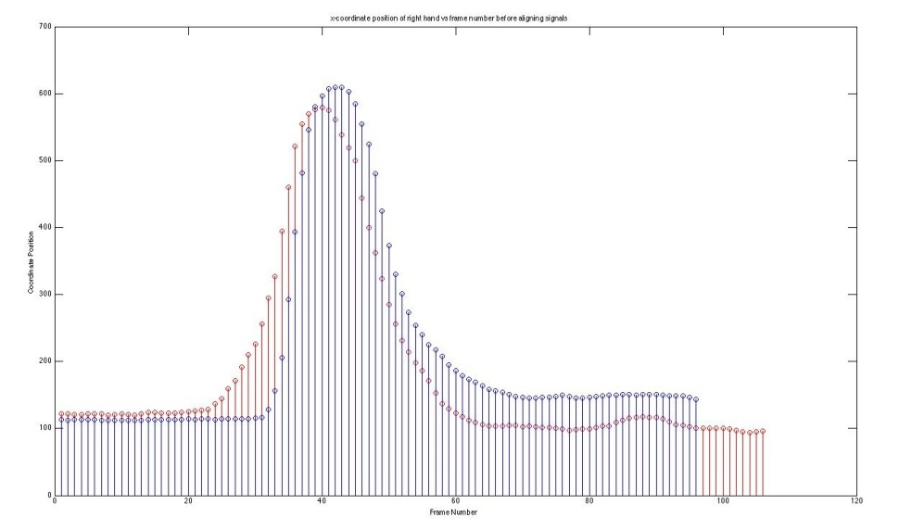
Automatic Dance Scoring – Data Alignment Module
Data Alignment Module
Even after translation, there is still a possibility of misalignment between the data of two dance moves
Data Alignment Module aims to bring the two signals to as close alignment as possible
Before
After

Slide 11
Automatic Dance Scoring – Data Analysis Module
Data Analysis Module

Slide 12
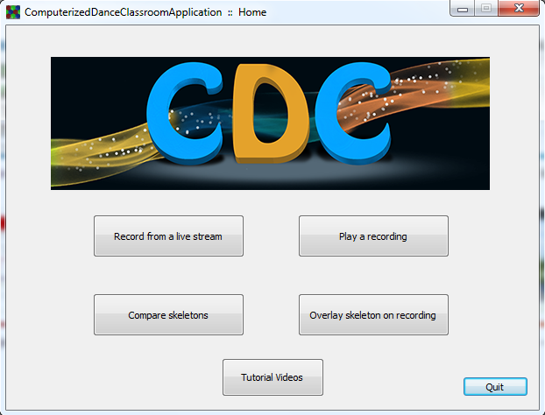
The Application

Slide 13
The Application
Screenshots?
Features

Slide 14
The Application
Screenshots?
Features

Slide 15
Extensions
Machine learning

Slide 16
Limitations

Slide 17
Commercial Aspect

Slide 18
Summary

